Slide 1
Marketing Campaign Results ANALYSIS
BY MOHD ASAD KHAN

Slide 2
Table of contents
01.
02.
03.
04.
05.
06.
Are there any null values or outliers? How will you handle them?
What factors are significantly related to the number of web purchases?
Which marketing campaign was the most successful?
What does the average customer look like?
Which products are performing best?
Which channels are underperforming?

Slide 3
01.
About Are there any null values or outliers? How will you handle them?

Slide 4
Determine which columns or variables in our dataset contain null values.
It is dependent on the data that we have that we perform different strategies such as Mean, Median, Mode, Forward or Backward Fill, Drop Column or Row.

Slide 5
02.
What factors are significantly related to the number of web purchases?

Slide 6
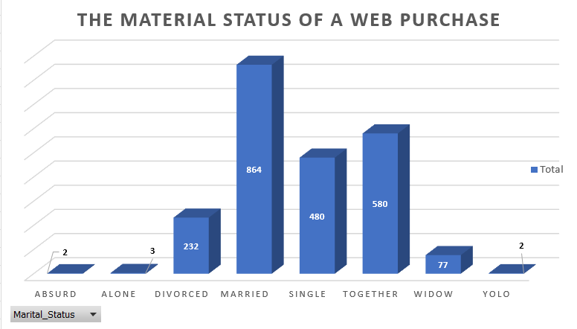

Slide 7
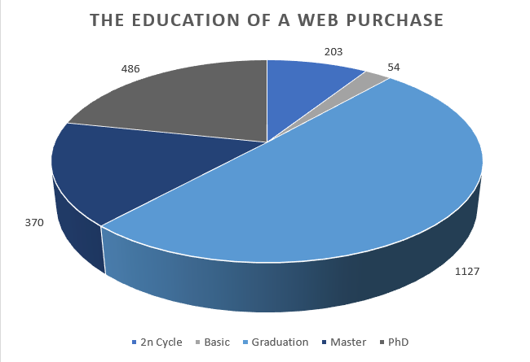

Slide 8
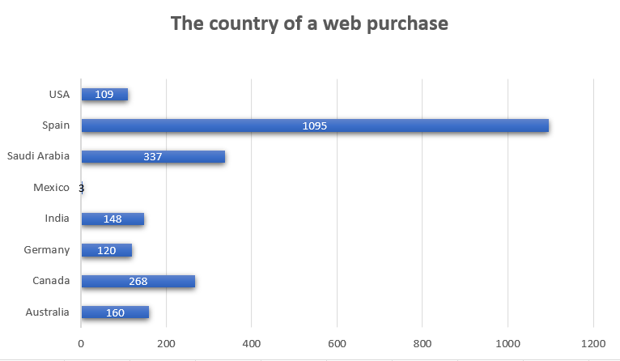

Slide 9
03.
Which marketing campaign was the most successful?

Slide 10
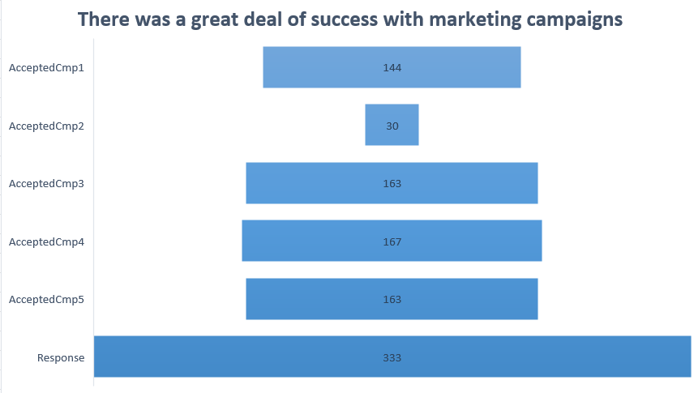

Slide 11
04.
What does the average customer look like?

Slide 12
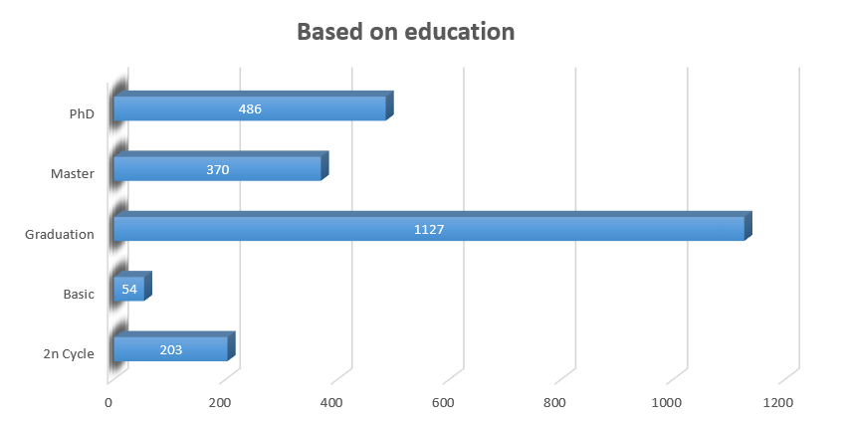

Slide 13
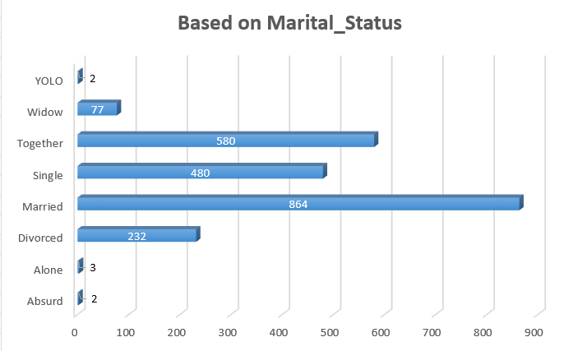

Slide 14
05.
Which products are performing best?

Slide 15
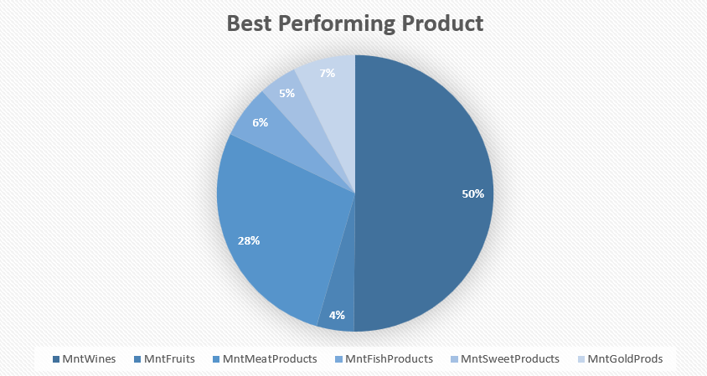

Slide 16
06.
Which channels are underperforming?

Slide 17
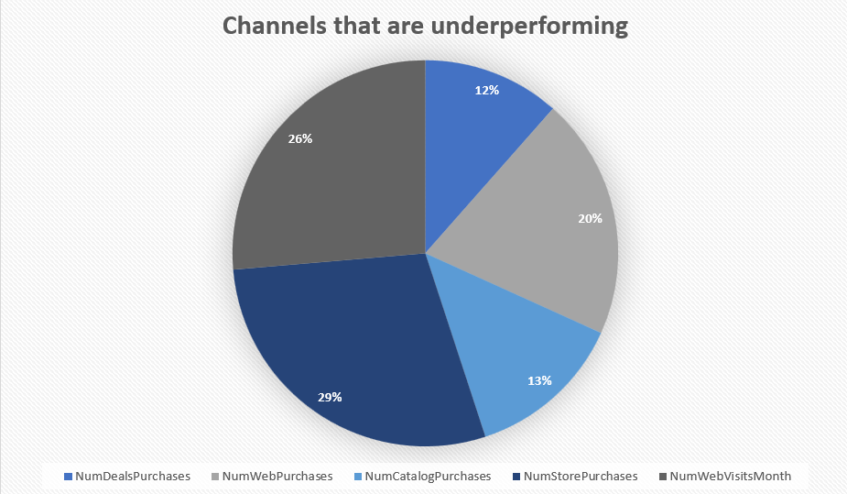

Slide 18
Thank You

